Slide 1
Using PCA to think about Intermodal Coupling
Fengling Hu
8/19/20

Slide 2
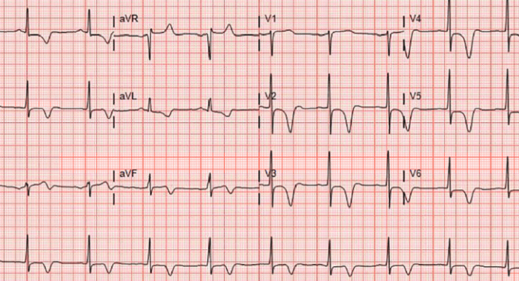
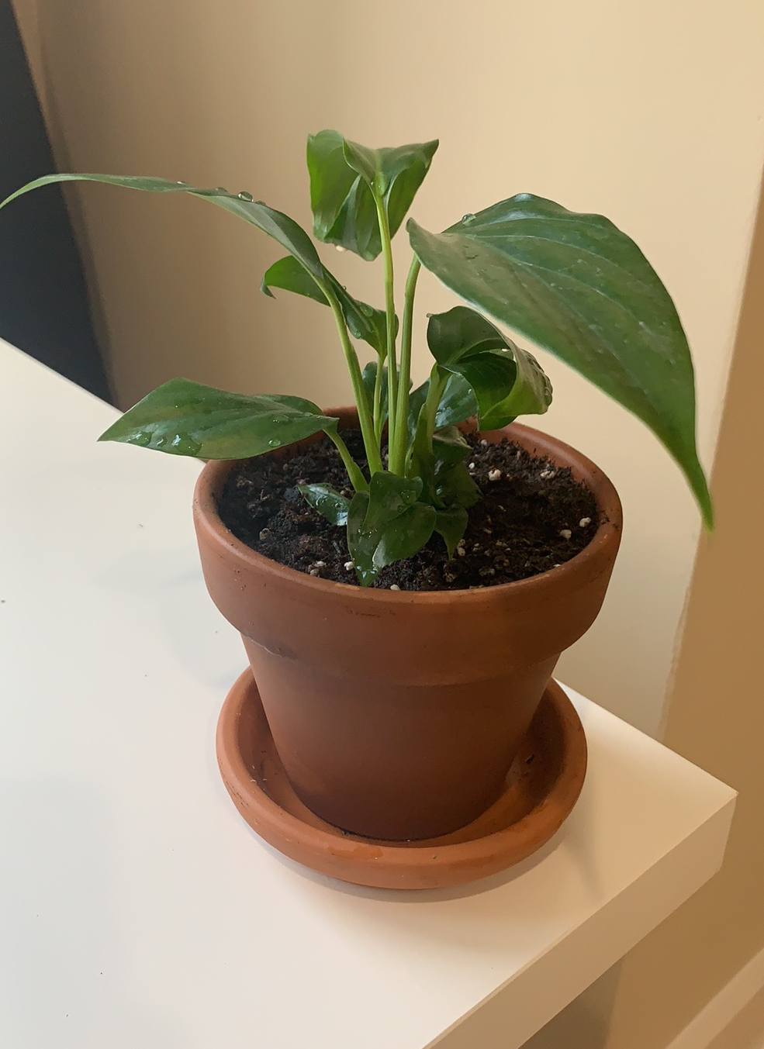

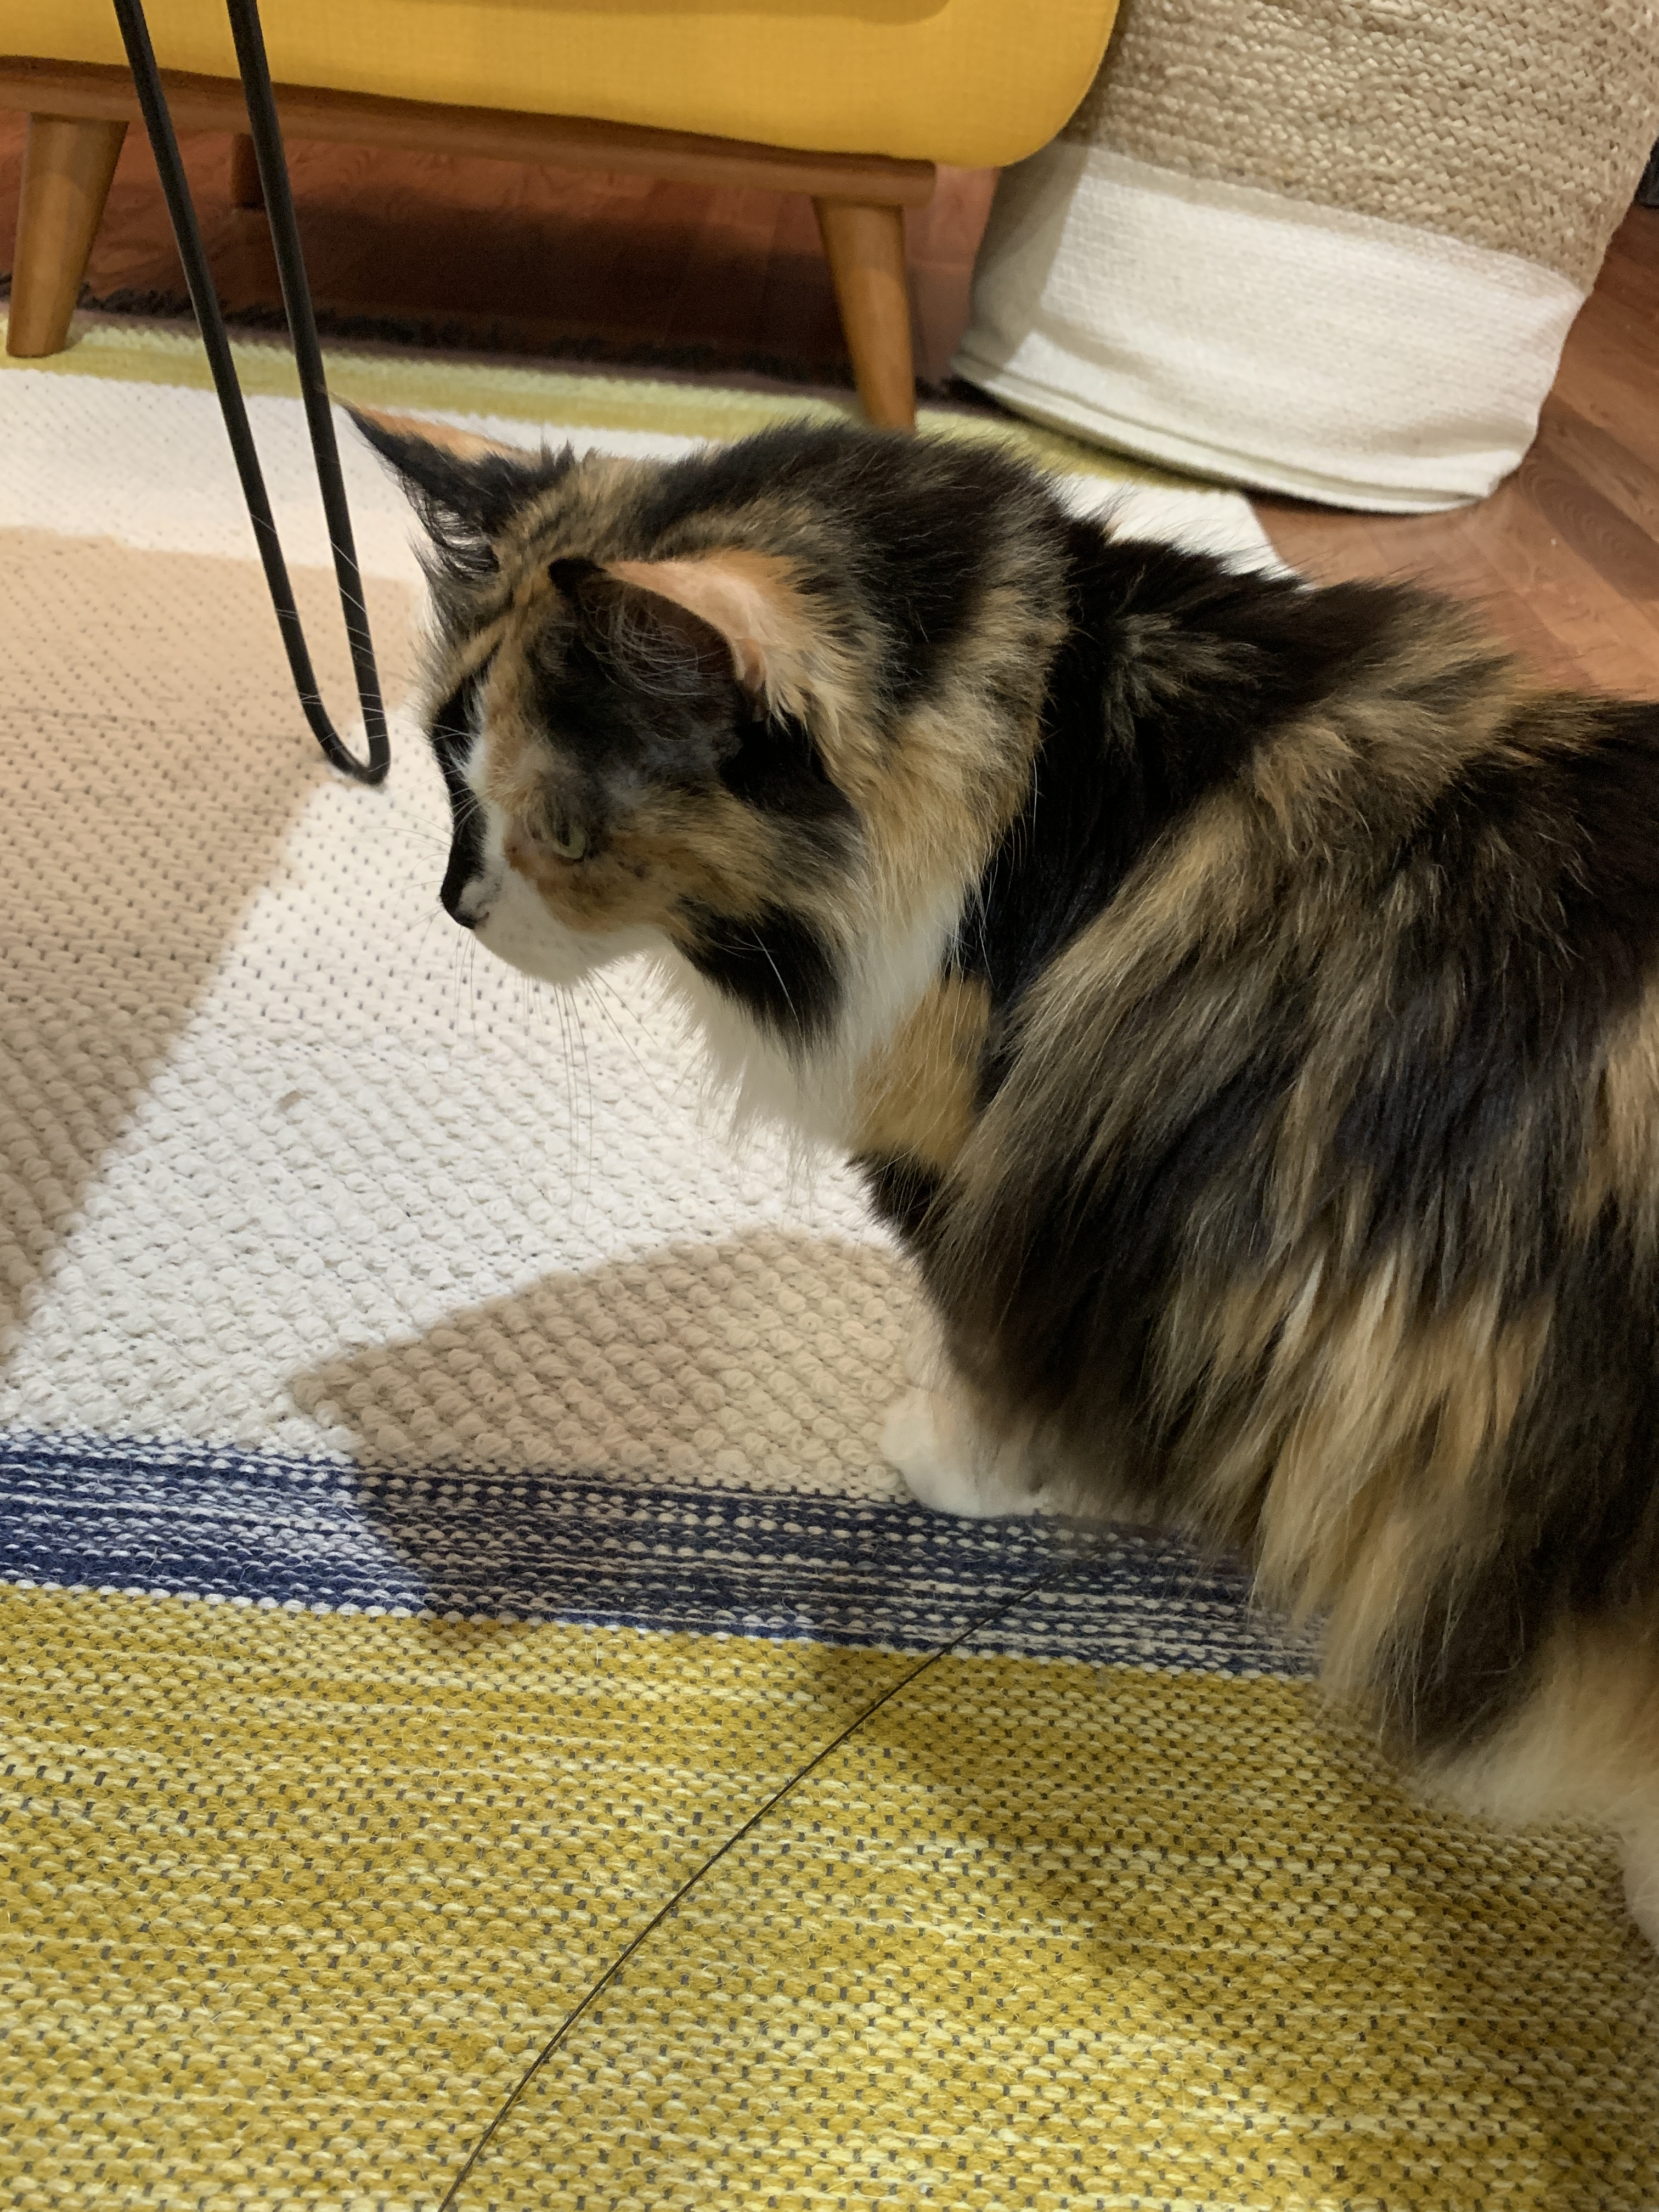

Hi everyone!
2nd year MD-PhD student
Now in cardiology!
Learning cardiologist’s version of physics...

Slide 3
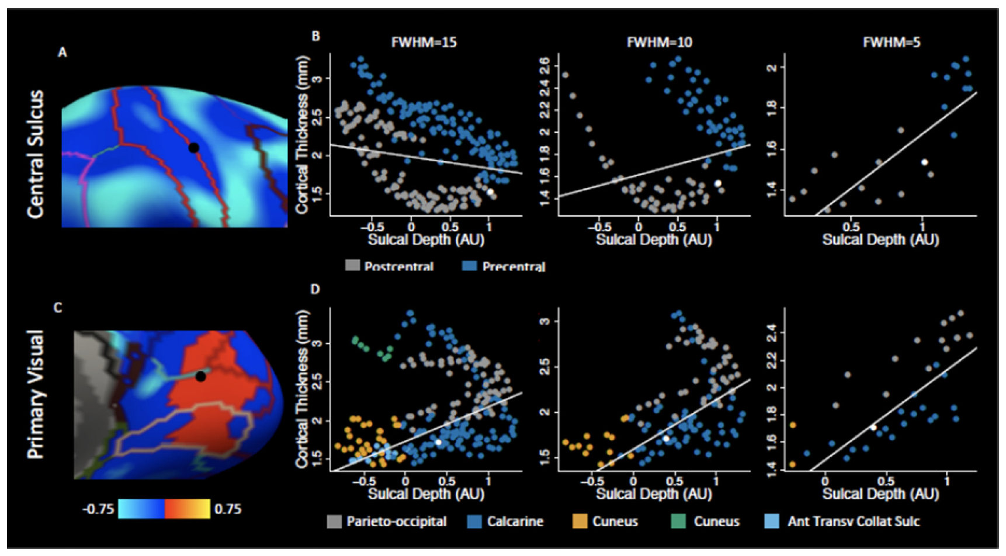
Brains differ across many individual modalities
Does the relationship between multiple modalities also differ?
Weighted linear regression has been used
Non-symmetric
Two modalities
Weighted PCA seems to
address these problems

Slide 4
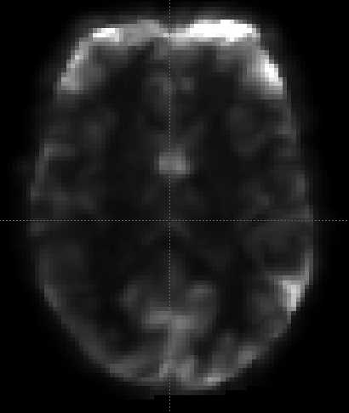
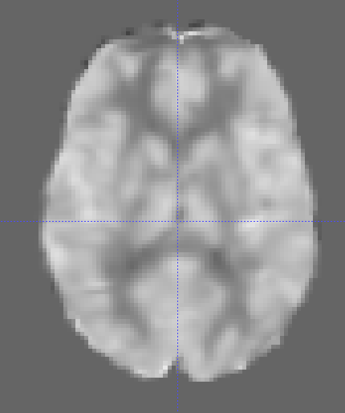
Take grey matter mask
For voxel_{i} in mask, take the cube of voxels around as “neighborhood”
Calculate measure of relationship between ALFF and CBF intensities
Perform PCA
Calculate proportion of variance explained by first eigenvector
How to normalize?
How to measure relationship?

Slide 5
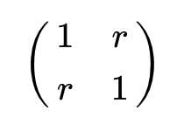
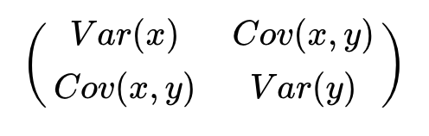
How to normalize?
Globally scale entire images
Scale each voxel neighborhood
Don’t scale
How to calculate measure of relationship?
Weighted correlation
Weighted covariance

Slide 6
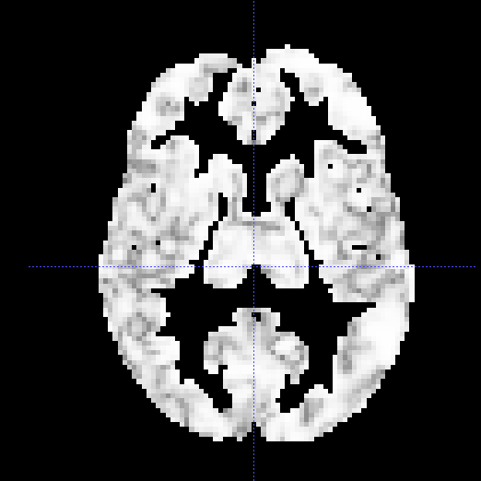
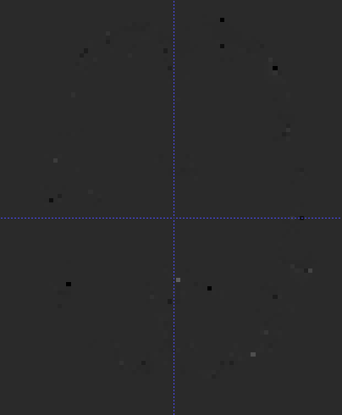
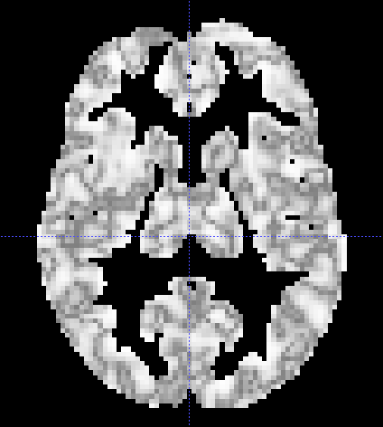
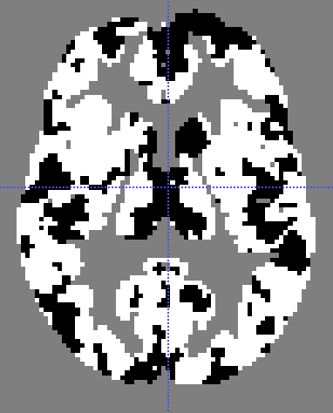
Globally-scaled with weighted covariance
Might preserve information between neighborhoods
PCA slopes don’t really work...
Don’t scale but use weighted correlation
Correlation automatically “scales” but does so in a weighted way
PCA slopes aren’t really meaningful...
Notes:
tan-1(slope)

Slide 7
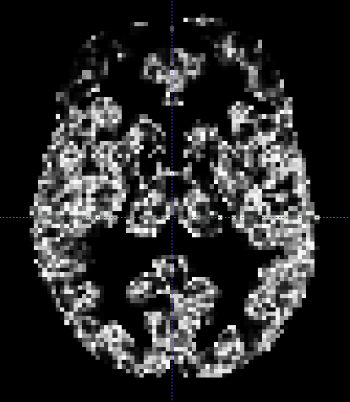
Hypothesis testing for each voxel across 831 images showing proportion of variance in first eigenvalue
voxel_proportion ~ sex + age + race + pcaslMotion + restMotion
Testing for sex and age differences. Controlling for race and motion.

Slide 8
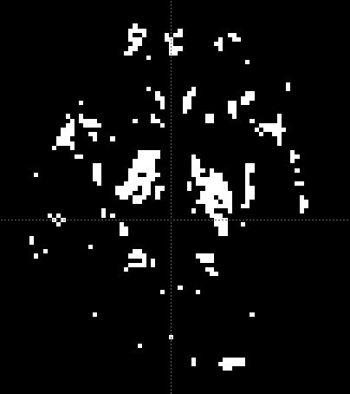
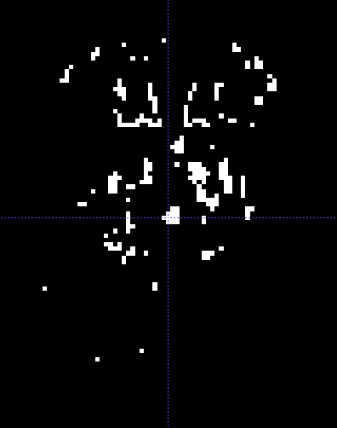
Globally-scaled weighted covariance
Mask of significant p-values for sex and age after FDR correction at 0.05
Interaction term and GAM p-values don’t survive correction

Slide 9
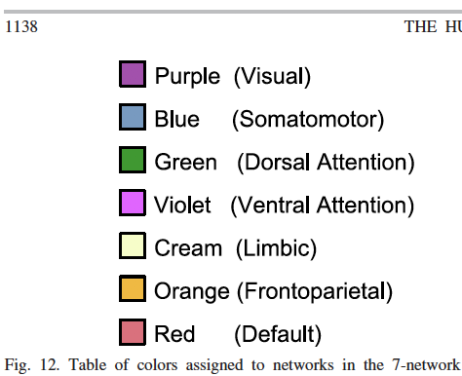
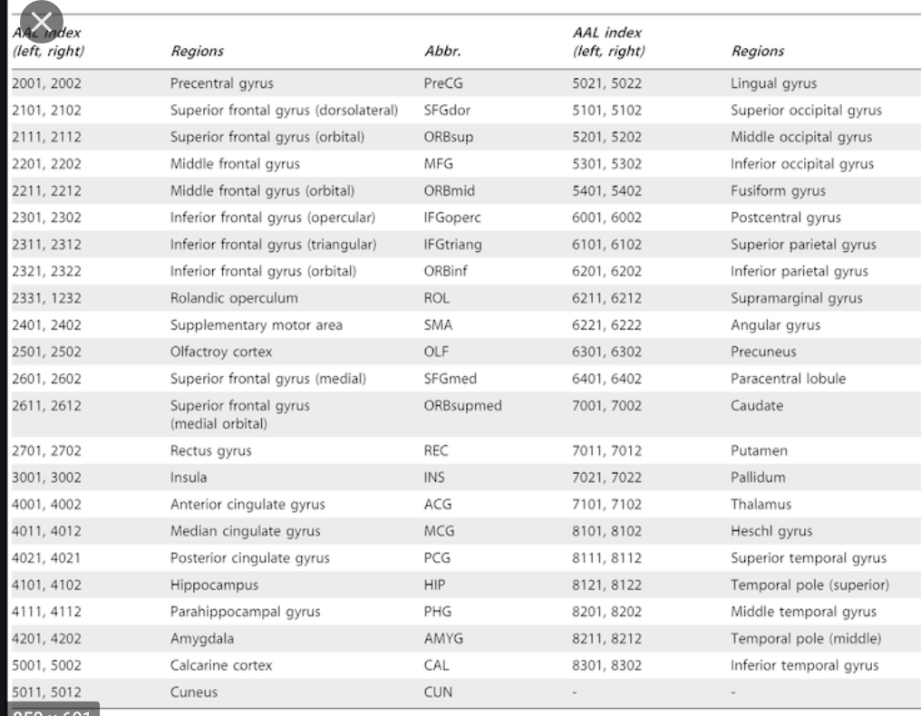
Proportion of significant p-values by region (On coupling with different options)

Slide 10
Future Directions
Trying to conduct spin tests between p-value map and atlas regions
Is proportion of significant p-values in a region dependent on alignment?
Using more than two modalities

